Slide 1
Air quality analysis in tamilnadu
Presented by
Karmugilan (212921106038)
Ece(3rd year)

Slide 2
Abstract
The aim of this study was to assess air quality in a suburban area over a one-month period. This analysis focused on measuring particulate matter (PM2.5), carbon monoxide (CO), sulfur dioxide (SO2), and ozone (O3) concentrations to understand the overall air quality and potential health risks in the area.

Slide 3
Procedure
Site Selection: We selected a monitoring site in a suburban residential area known for its proximity to traffic and industrial zones.
Data Collection: We used specialized air quality monitoring equipment to measure PM2.5, CO, SO2, and O3 levels at 15-minute intervals.
Data Analysis: Collected data was analyzed using statistical software to calculate daily averages and identify any trends or anomalies.

Slide 4
Procedure
4.Weather Data: Concurrent meteorological data such as temperature, humidity, and wind speed were recorded to assess their potential influence on air quality
5.Health Risk Assessment: We used established air quality index (AQI) standards to evaluate the health risks associated with the measured pollutants

Slide 5
Code program
SELECT Location, AVG(PM25) AS Avg_PM25 FROM AirQualityData GROUP BY Location;
SELECT Timestamp FROM AirQualityData WHERE CO > 5; -- Modify the threshold as
Needed
SELECT DATE(Timestamp) AS Date, MAX(SO2) AS Max_SO2 FROM AirQualityData GROUP BY Date;

Slide 6
Code program
SELECT DATE(Timestamp) AS Date, AVG(O3) AS Avg_O3 FROM AirQualityData GROUP BY Date ORDER BY Date;

Slide 7
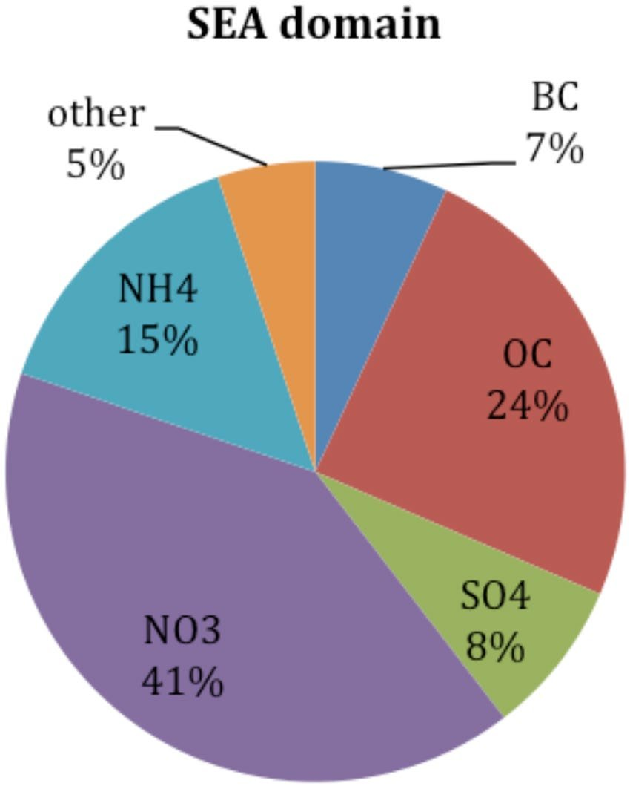
Output

Slide 8
Result
For the analysis of air quality we have determine the following in the atmosphere
PM2.5 Concentrations
CO Levels:
SO2 and O3:
Health Implications
Meteorological Factors

